Slide 1

U.S. Department of Housing and Urban Development
Jackson Field Office

Slide 2

HUD Mission
Create strong, sustainable,
inclusive communities
and quality affordable housing for all.

Slide 3
Jackson Office Overview
25 employees
Office of Field Policy and Management
Office of Public Housing
Office of Fair Housing and Equal Opportunity
Office of Community Planning and Development
Office of Housing
Multifamily Housing Asset Management
Office of Housing Counseling

Slide 4
Major HUD Programs in Mississippi
Housing Counseling Agencies
Continuums of Care
Public Housing Authorities
Multifamily Properties
CDBG Entitlement Communities
HOME Participating Jurisdictions

Slide 5
Agency Initiatives
Section 3
Lead hazard control and healthy homes
Place based initiatives
Reduce homelessness
Covic-19 rental assistance
Foreclosure prevention

Slide 6
Programs Available to Assist Constituents in Need

Slide 7
Public Housing
Established to provide decent, safe, and sanitary rental housing for eligible low-income families, the elderly, and persons with disabilities
Comes in all sizes and types, from scattered single-family houses to high-rise apartments
Limited to low-income families and individuals; Public Housing Agency (PHA) determines eligibility based on annual gross income, whether one qualifies as elderly, a person with a disability, or as a family, and U.S. citizenship or eligible immigration status
Very long wait lists!

Slide 8
Low Income Public Housing: How It Works
Application Process: Resident’s Responsibilities
Contact local PHA for information on application process and waiting list timeframes
Application Process: PHA’s Responsibilities
Determines eligibility and places applicant on waiting lists
Determines tenant rental portion based on income, presents lease, and collects security deposit
Applicant fills out application
HUD does not accept applications or maintain waitlists

Slide 9
Housing Choice Vouchers
HUD’s major program for assisting very low-income families, the elderly, and the disabled to afford decent, safe and sanitary housing
Participants are free to choose housing that meets the requirements of the program and are not limited to units in subsidized housing projects
Vouchers are administered locally by Public Housing Agencies (PHAs) so applications are submitted to the PHA
Participants must find suitable housing with landlord that agrees to lease under the program
Very long wait lists!

Slide 10
Housing Choice Vouchers: How It Works
Tenant’s Responsibilities
Completes application for voucher
PHA’s Responsibilities
Administers voucher to participant
Determines rental portion for tenant
Signs lease with landlord
Pays portion of rent to landlord
Pays rental assistance to landlord
Ensures unit meets health & safety standards
Determines eligibility and places applicant on waiting list
HUD does not accept applications or maintain waitlists

Slide 11
Subsidized Multifamily Housing Developments
Application Process: Resident’s Responsibilities
Contact local management agent for information on application process and waiting list timeframes
Application Process: Management Agent’s Responsibilities
Determines eligibility and places applicant on waiting lists
Determines tenant rental portion based on income, presents lease, and collects security deposit
Applicant fills out application
HUD does not accept applications or maintain waitlists

Slide 12
Programs to Address Homeless
Continuum of Care Program (CoC)
Promotes community-wide commitment of ending homelessness
Funding is provided for efforts to quickly re-house homeless individuals and families
Grants are offered through a competitive process for new construction; acquisition, rehabilitation, or leasing of buildings to provide transitional or permanent housing; rental assistance; supportive services; and re-housing services
Emergency Solutions Grants Program (ESG)
Awarded by formula to states, cities, and counties
HUD-Veterans Affairs Supportive Housing Program (HUD-VASH)
Program combines Housing Choice Voucher rental assistance for homeless veterans with case management and clinical services provided by the Department of Veterans Affairs
Provide essential services related to emergency shelter, rehabilitation and conversion of buildings to be used as emergency shelters, operation of emergency shelters, and homeless prevention services

Slide 13


Housing Counseling
HUD Certified Housing Counseling Agencies provide free or low-cost advice on:
  Buying a home
  Renting
  Mortgage default
  Foreclosure avoidance
  Credit issues
  Reverse mortgage
  Homeless
  Find a Housing Counseling Agency:
  1-800-569-4287

Slide 14

Fair Housing
The Fair Housing Act:
Protects people from discrimination when they are renting or buying a home, getting a mortgage seeking housing assistance, or engaging in other housing-related activities.
To file a Fair Housing claim:
https://www.hud.gov/program_offices/fair_housing_equal_opp/online-complaint
1-800-669-9777
Prohibits discrimination in housing because race, color, national origin, religion, sex, familial status or disability

Slide 15
Mississippi’s Annual Affordable Housing Conference 2024
FHA Update
April 18, 2024
Prepared by:
Rachel A. Lavelanet, Director
Program Support Division
Atlanta Homeownership Center

Slide 16
HUD’s Strategic Goals
Support
Underserved Communities
Ensure
Access and Increase Production of Affordable Housing
Promote
Homeownership
Advance
Sustainable Communities

Slide 17
What is FHA?
The Federal Housing Administration, generally known as "FHA", provides mortgage insurance on loans made by FHA-approved lenders throughout the United States and its territories.
FHA insures mortgages on single family homes, multifamily properties, residential care facilities, and hospitals.
It is one of the largest insurers of mortgages in the world, insuring more than 46 million mortgages since its inception in 1934, and one of the largest drivers of affordable homeownership for minority borrowers.
Notes:
WHAT IS FHA and HOW IT HELPS PEOPLE ACHIEVE HOMEOWNERSHIP?
FHA stands for the Federal Housing Administration, a government agency within the Department of Housing and Urban Development (HUD). FHA was established by the National Housing Act on June 27, 1934, to facilitate home financing, improve housing standards, and increase employment in the home construction industry in the wake of the Great Depression.
FHA doesn't make loans. Instead, it insures loans so that if buyers default for some reason, the lenders will get their money. This encourages lenders to give mortgages to people who might not otherwise qualify for loans.
What is FHA and Its Importance in the Market: We are keenly aware of our responsibility to play a countercyclical role in supporting the housing market during times of both financial challenge and natural disasters. During the time of the COVID-19 pandemic and beyond, HUD, its Office of Housing, and FHA are committed to helping first-time homebuyers and other families attain the financial benefits and economic independence realized through homeownership.

Slide 18
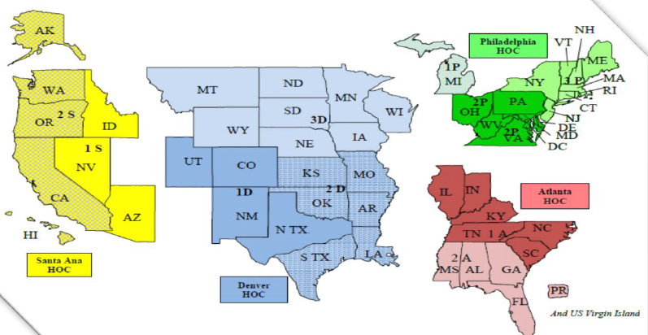
Atlanta Homeownership Center (AHOC)
For Questions or for Additional Information Contact the
FHA Resource Center at 1 (800) CALL FHA
Email: answers@hud.gov
FAQs: www.hud.gov/answers
  Becoming a Homeowner
  Qualifying for an FHA loan;
  FHA Loan Products;
  Down payment Assistance;
  Purchasing a “HUD Home”;
  Foreclosure Prevention and more!
AHOC’s jurisdiction includes
AL, FL, GA, IL, IN, KY, MS, NC, PR, SC, TN, and the USVI
Notes:
FHA Single-Family activities are managed by 4 homeownership Centers (HOCs). The Atlanta Homeownership Center has purview over the FHA Single Family activity in MS. The HOCs are comprised of 5 Divisions:
Program Support: Works with Nonprofit and Govt Entities that wish to do business with FHA; and provides FHA Marketing and Outreach activities.
Processing and Underwriting::Reviews FHA lender activity (FHA insured loans)
Operations and Customer Service: Provides support to the HOC – manages HOC funding and the FHA Resource Center
Real Estate Owned: Oversees the Management and Marketing of REO inventory (HUD Homes)
Quality Assurance: Monitors FHA-approved lenders

Slide 19
Benefits of FHA
Down payments as low as 3.5 percent vs. 10% or more in the conventional market
Not credit score-driven: FHA looks at alternative forms of credit--must be mortgage credit worthy and have stable income. Average credit score falls in the mid-600’s
Key component of FHA is the mortgagee’s (lender’s) ability to file an insurance claim in case of default by the borrower; FHA will pay a claim to the lender for the unpaid principal balance
FHA has a Loss Mitigation Program designed to help borrowers who experience a loss in income remain in their homes and avoid foreclosure

Slide 20
FHA Loan Qualifications
FHA Insures Multiple Property Types
An Inspection must occur, and the property must meet minimum property standards
Property Can’t Exceed FHA’s Loan Limit
The Property must Be the Buyer’s Primary Place of Residence
3.5% Minimum Required Investment (may come from an acceptable source)
Borrower Must Have “Stable” Employment
Debt to Income Ration of 43% or Less (31% towards housing costs; and 43% towards housing expenses and debt)
Notes:
These are the basic qualifying factors. The Debt-to-Income (DTI) ratio can be higher based on what loan program is involved. DTI for Energy Efficiency Mortgages is 33/45.

Slide 21
FHA in Mississippi
FHA Insurance in Force: 79,657
Total Loan Value: $12,262,359,467
Average FHA loan Amount: $153,950
Notes:
FHA does moderate business in the state of MS:
There are almost 80,000 FHA insured loans in MS
The value of those loans is $12.3 Billion
The average loan amount in MS is $153,950
FHA Insures up to almost $500,000 in MS! That is a testament to where the market is lately. Years ago, we may not have thought that FHA would insure that much. FHA is competitive in today’s market:
FHA has approximately a 30% market share for first-time homebuyers and
an approximate 80% market share for minority fist-time homebuyers.

Slide 22
FHA’s Loan Programs
Adjustable-Rate Mortgages (ARM)
Basic Home Loan (203B)
Condominium Mortgage (234C)
Disaster Victim Mortgage (203H)
Energy Efficiency Mortgage (EEM)
Home Equity Conversion Mortgage (HECM)
Manufactured Housing
Rehabilitation Mortgage (203K)
Streamline Refinance
Notes:
The take-away here is that FHA has a loan product designed to fit most any consumer’s needs from purchase to home equity conversion mortgage to refinance. Adjustable-Rate Mortgages: An adjustable-rate mortgage, or ARM, is a home loan with an interest rate that can change periodically. This means the monthly payment can go up or down. Basic Home Mortgage Loan 203 (b): This is the most popular of FHA loan programs! To provide mortgage insurance for a person to purchase or refinance a principal residence. The mortgage loan is funded by a lending institution, such as a mortgage company, bank, savings and loan association and the mortgage is insured by HUD. Borrower must meet standard FHA credit qualifications, approx. 96.5% financing, eligible properties are one-to-four-unit structures.
Condominium Mortgages: Buying a Condo is a home purchase, but condo financing is not entirely like mortgages for single family homes. What makes a condo mortgage different is the underwriting process. During underwriting, lender will review the financial health of the condo association for the property. (Example: Percentage of units that are rented vs. owner-occupied, amount of money held in reserve for maintenance, etc.)
Disaster Victim Mortgages 203 (h): This Section 203(h) program allows FHA to insure mortgages made by qualified lenders to victims of a major disaster who have lost their homes and are in the process of rebuilding or buying another home.
Energy-Efficient Mortgages (EEM): Helps families save money on their utility bills by enabling them to finance energy efficient improvements with their FHA-insured mortgage. Cost-effective energy improvements can lower utility bills and make more income available for the mortgage payment.
HECM (Home Equity Conversion Mortgage): Reverse mortgages are increasing in popularity with seniors who have equity in their homes and want to supplement their income. The Federal Government’s reverse mortgage is called a Home Equity Conversion Mortgage (HECM) and is only available through an FHA-approved lender. The borrower can withdraw a portion of the equity in his/her home. The amount that will be available for withdrawal varies by borrower and depends on:
Age of the youngest borrower or eligible non-borrowing spouse (minimum required age is 62);
Current interest rate; and
Lesser appraised value or the HECM FHA mortgage limit or the sales price.
Manufactured Housing: Structures that are transportable in one or more sections. They are to be used as a single-family residence, must be connected to utilities and include electricity, a water supply, waste systems, heating and possibly cooling. They must meet the Manufacture Home Construction and Safety Standard (MHCSS) and have a HUD Certification Label.
Rehabilitation Mortgage 203(k): 203(k) offers a solution that helps both borrowers and lenders, insuring a single, long-term, fixed or adjustable- rate loan that covers both the acquisition and rehabilitation of a property.
Streamline Refinance: Refers to the refinance or an existing FHA-insured mortgage requiring limited borrower credit document and underwriting.

Slide 23
FHA’s Disaster Mortgage (203H) Loan
Purpose of this program is to protect lenders against the risk of default on mortgages to qualified disaster victims.
Eligibility
Properties located in Presidentially designated disaster areas.
The applicant’s residence must have been destroyed or damaged to such an extent that reconstruction or replacement is necessary.
Refer to the Federal Emergency Management Agency’s (FEMA) website for areas affected and declaration dates at: www.fema.gov/disasters
Benefits of 203(h):
Borrower is not required to make the minimum required investment MRI. The borrower is eligible for 100% financing
May be used in conjunction with a 203(k) for purchase and/or refinances
The minimum credit score is 500

Slide 24
FHA’s Rehabilitation(202K) Loan
Benefits/Requirements
Combine the cost of the home and renovation into 1 mortgage
Make improvements after closing
Increase Property Value and build equity
Refinance, stay in home while improvements are made
Property must meet Minimum Property Requirements at Project Completion (after closing)
May use Down-Payment Assistance
Standard 203K
$5000 minimum in eligible improvements
A 203K Consultant is required
Fees and costs related to the renovation can be rolled into the loan
Streamline K
$35,000 maximum in repairs
Minor remodeling and non-structural repairs
The Borrower does not have to use a 203K Consultant (if used the fee can’t be rolled into the loan)

Slide 25
Home Equity Conversion Mortgage (HECM)
FHA Released a Draft Mortgagee Letter for Industry Feedback
Allows acceptance of a verbal verification of the annual occupancy certification;
Shortens the waiting period for assignment to FHA following a mortgagee-funded cure;
Aligns post-due and payable appraisal requirements for all HECMs;
Permits the optional inclusion of Homeowners’ Association dues in the total arrearage for property charge repayment plans; and
Establishes a mortgagee incentive, and increasing borrower incentives, for completing foreclosure prevention actions such as a Short Sale or Deed-in-Lieu of Foreclosure.

Slide 26
FHA and Student Loans
FHA Changed the Way It Calculates Student Loan Payments
For outstanding Student Loans, regardless of the payment status, the Mortgagee must use:
the payment amount reported on the credit report or the actual documented payment, when the payment amount is above zero; or
0.5% of the outstanding loan balance, when the monthly payment reported on the Borrower’s credit report is zero.
Exception: Where a student loan payment has been suspended in accordance with COVID-19 emergency relief, the Mortgagee may use the payment amount reported on the credit report or the actual documented payment prior to suspension, when that payment amount is above $0.
Notes:
Lenders want to see less than 43% of one’s monthly income going to debt payments, which include student loan payments.
We are now aligned with the GSE’s allowing the use of 0.5%. We also allow the actual payment to be utilized if payment amount and terms is provided by the debt hold including when it is LESS than .5%.
The Mortgagee must include all Student Loans in the Borrower’s liabilities, regardless of the payment type or status of payments.

Slide 27
Accessory Dwelling Units (ADUs)
A single habitable living unit with means of separate ingress and egress that meets the minimum requirements for a living unit An ADU is a private space that is subordinate in size and can be added to, created within, or detached from a primary one-unit Single Family dwelling, which together constitute a single interest in real estate.
Allows for the inclusion of rental income
Increases the supply of housing in a community
Enables more first-time homebuyers, seniors, and inter-generational families to leverage the power of ADUs to enhance the generational wealth building potential of homeownership.
Notes:
An ADU is a permanent dwelling that exists besides, near, or in conjunction with a larger, pre-existing home. An ADU is a secondary housing unit on a single-family residential lot and can come in a variety of forms – it can be attached to or detached from the primary living unit. Examples:
Carriage House
Basement/Garage Apartment
“Granny Flat”
Are tiny homes the same as ADU?
An ADU is a permanent dwelling that exists besides, near, or in conjunction with a larger, pre-existing home. Tiny homes, on the other hand, tend to have wheels like RVs. Those micro dwellings that aren't mobile typically sit on a small parcel of land that does not contain any other buildings. If it has wheels, it’s not an ADU.

Slide 28
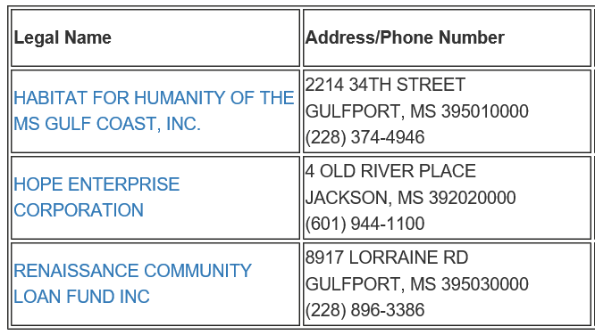

FHA’s Single-Family Nonprofit Program - MS
HUD Homes Discount Sales
Secondary Financing
FHA Mortgagor
Notes:
Addresses HUD’s strategic goals:
Support Underserved Communities
Increase Access to Affordable Housing
Promote Homeownership
FHA has 3-approved NPs in MS: Habitat for Humanity of the MS Gulf Coast, Hope Enterprise Corporation and Renaissance Community Loan Fund (all 3 may be in attendance at the Conference)
FHA recognizes its partnership with the MS Home Corp. They do not appear on the FHA-approval Roster because approval is not required for Government Entities. MHC is considered as a Govt. Entity and participates in this program. MHC is a provider of Secondary Financing with FHA-insured mortgages.
ADVANCE SUSTAINABLE COMMUNITIES

Slide 29
HUD Homes/Discount Sales Program
FHA-Approved NPs and Govt. Entities may:
Once the NPs Acquires the Property, it must
Purchase HUD Homes at a Discount
Exclusive-Listing Bidding Period
10% Is the Standard Discount
30% when the Property is located in a Revitalization Zone
Discount applies at Closing
Rehab the property according to local code
Sell the property to a low-to-moderate income person
Transaction may not result in a Conflict of Interest
Not exceed 110% Net Development

Slide 30
Secondary Financing
Often Called Down Payment Assistance
No costs associated with the Secondary Financing are financed into the FHA-insured first Mortgage
The Secondary Financing payments must be included in the total Mortgage Payment
The Secondary Financing must not result in cash back to the Borrower except for refund of earnest money deposit or other Borrower costs paid outside of closing
There is no maximum Combined Loan to Value (CLTV) for Secondary Financing loans provided by HUD-approved Nonprofits
The Second Lien may not provide for a balloon payment within 10 years from the date of execution.
“Silent” Second Lien filed in the assistance amount
May be used to meet the Buyer’s FHA required 3.5% MRI
Forgiven over time
Buyers agrees to make the property their primary place of residence

Slide 31
FY23 FHA Homebuyer Assistance Provided in MS
In FY23, $339.3M in Homebuyer Assistance was provided by Nonprofits and Government Entities in combination with FHA-insured Loans in Region IV.
FHA-approved Nonprofit Organizations offered over $7M in homebuyer assistance to 471 consumers through FHA‘s Secondary Financing Program.
The average assistance received per household was $14,860.
2 FHA-approved NPs in MS provided $303,960 in homebuyer assistance to 28 consumers.
Notes:
FY24 data won’t be available until the end of the FY (October 2024)

Slide 32
FHA Mortgagor
FHA-Approved NP or GE may qualify for an
FHA-insured Mortgage
Offered the same terms as an owner-occupant
Same loan qualification applies for the 203b and 203K products
3.5% MRI requirement applies
FHA Loans are assumable
Available for Loss Mitigation
Used to operate Long-term Affordable Housing Programs
Once approved the NP will need to find a Lender willing to underwrite these types of loans

Slide 33
Good Neighbor Next Door Initiative
The GNND sales incentive permits an Owner-Occupant Borrower (full-time Law Enforcement/ Officer/Teacher/Firefighter or EMT) who wish to purchase a HUD Home at a 50% discount
Property located in a HUD-designated Revitalization Area with FHA-insured financing at a 50% discount off the list price
Low $100 Down Payment
HUD Pays Closing Costs
The Good Neighbor Next Door (GNND) participant must live in the Property as their sole residence for an owner-occupancy term of 36 months

Slide 34
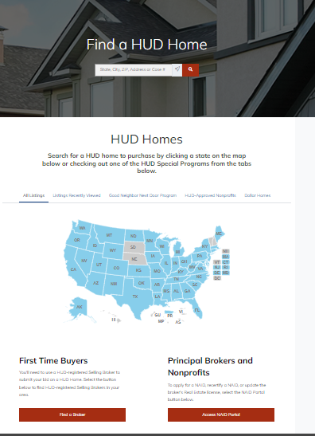
REO Inventory (HUD Homes):www.HUDHomeStore.gov
Notes:
Be careful! HUD will never charge for this list. Often there are similar websites that charge fees.
Bookmark this site: www.HUDHomeStore.gov or if you forget go to www.HUD.gov and follow the prompts for “Homes for Sale”.

Slide 35
REO (HUD Homes) Inventory in MS
Mississippi has: 184 Properties as of 4/9/24
*Custodial Inventory: 104
Available Properties in MS: 79
Vacant Lot: 1
*These are properties that have an FHA Reverse Mortgage Loan (HECM) and are held off the market
Notes:
REO inventory is low across the Atlanta Homeownership Center’s jurisdiction for two reasons:
Inventory returned to pre housing market crash levels; and
The Department uses the Claims Without Conveyance of Title disposition method for many properties
The Department has more Custodial Inventory than available properties. Custodials are properties that are associated with FHA’s HECM/Reverse Mortgage loans. It takes a long time before these properties are available for resale to the public. Heirs are offered fist right of refusal and it is often difficult in locating heirs. The process involves multiple government agencies.
In recent weeks, REO sales have increased and surpassed acquisitions.

Slide 36
Housing Counseling
HUD provides support to a nationwide network of Housing Counseling Agencies (HCAs) and Counselors. They provide tools to current homeowners, prospective home buyers, renters, homeless, and victims of disasters, so they can make responsible choices to address their housing needs. https://www.hud.gov/program_offices/housing/sfh/hcc/hcc_home
To find a Partnering HCA or Certified Counselor go to: https://apps.hud.gov/offices/hsg/sfh/hcc/hcs.cfm
Call (800) 569-4287 or TTY (800) 877-8339
Notes:
HUD -approved Housing Counseling has been helping consumers across America make informed housing decisions for more than 50 years. Wherever your constituents are in the housing process, the nationwide network of HUD-approved housing counseling agencies is here to assist-- providing insights and answers they need to make the choices that are right for them. Services range from homebuyer education courses, budgeting and credit counseling, rental counseling, foreclosure prevention and others. Help is a phone call away!
HUD-approved HCAs: in MS: Several may be in attendance at the Conference
Breakthrough Community Service MS Housing Partnership
D&E: A Housing and Empowerment Center North MS Rural Legal Services
Hancock Housing Resource Center
Housing Education and Economic Development
Mercy Housing and Human Development
MS Faith-based Coalition for Community Revival
Money Management International (Biloxi)
Neighborhood Assistance Corp. of America

Slide 37
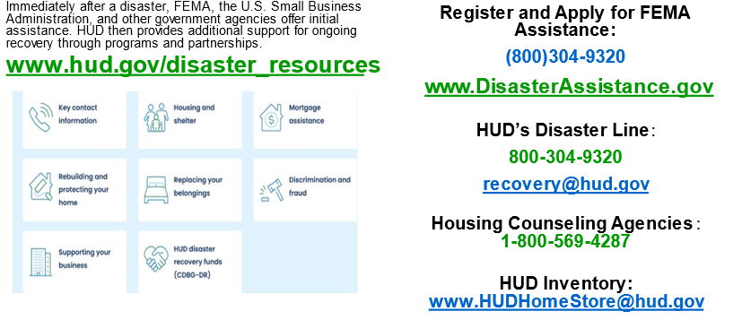
HUD’s Disaster Resources

Slide 38
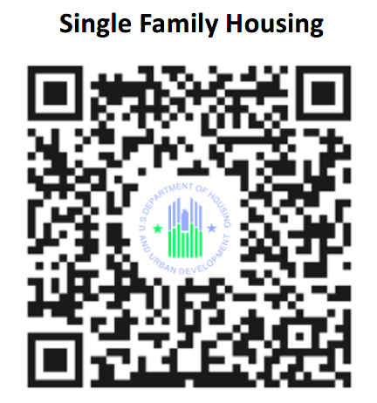
FHA Resource Center
1 (800) CALL FHA or 1 (800) 225-5342
Persons with hearing or speech impairments may access this number via TTY by calling the Federal Information Relay Service at (800) 877-8339
Email: answers@hud.gov
FAQs: www.hud.gov/answers
Notes:
FHA SF Quick Links:
SF Home Page
Housing Handbook, Housing Notices, MLs
FAQs
Office of Housing Counseling
FHA INFO (Subscribe)
FHA-Approved Condos
HUD Homes for Sale (REO)
SF Webinars
FHA-Approved Lenders
Dispelling Myths and Buying a Home

Slide 39
U.S. Department of Housing and Urban Development
Jackson Field Office
Panel Q &A

Slide 40

Community Planning and Development

Slide 41
How can I receive funding from HUD?

Slide 42
Who do I contact to get funding?

Slide 43
What funding is available?

Slide 44
What activities are funded with your grant programs?

Slide 45
What are cross cutting requirements and how do they apply to a HUD activity?

Slide 46
Public and Indian Housing/ Multifamily Housing

Slide 47
Who would a tenant contact if they are having problems with their housing units?

Slide 48
What is the protocol for anyone who has problems with their voucher?

Slide 49
What are the options to redevelopment a housing portfolio?

Slide 50
How does a person obtain housing or a Housing Choice Voucher?

Slide 51
What are some of the eligibility requirements for housing or a voucher?

Slide 52
Multifamily Housing

Slide 53
Public Housing vs Multifamily Housing
What’s the difference?

Slide 54
How has staffing changed in the Southeast region over the last two years, and what are the main focuses now?

Slide 55
What are the top priorities for the Southeast region, especially concerning site visits and monitoring troubled properties?

Slide 56
Can you give a rundown of upcoming funding opportunities in housing, including deadlines and what they're for?

Slide 57
What's the Multifamily Benchmarking Initiative, and why is it important for HUD-assisted properties?

Slide 58
What does the Green and Resilient Retrofit Program aim to achieve, and how does it help multifamily properties?

Slide 59
How are properties chosen for the Comprehensive Cohort, and how does the assessment process help with renovations?

Slide 60
What should property owners do if they want to get involved in these programs?

Slide 61
Office of Housing Counseling

Slide 62
What services does HUD's Office of Housing Counseling provide?

Slide 63
How can I find a HUD-approved housing counselor in my area?

Slide 64
Are there any fees associated with HUD housing counseling services?

Slide 65
Can HUD housing counselors help me with specific issues such as foreclosure prevention or rental assistance?

Slide 66
What qualifications do housing counselors have, and how are they trained and certified by HUD?

Slide 67
What funding is available for HUD-approved Housing Counseling Agencies?

Slide 68
Our agency/ municipality is new to all of this, so we don’t know where to start. Does HUD provide any technical assistance that can help us navigate these programs/ funding sources ?

Slide 69
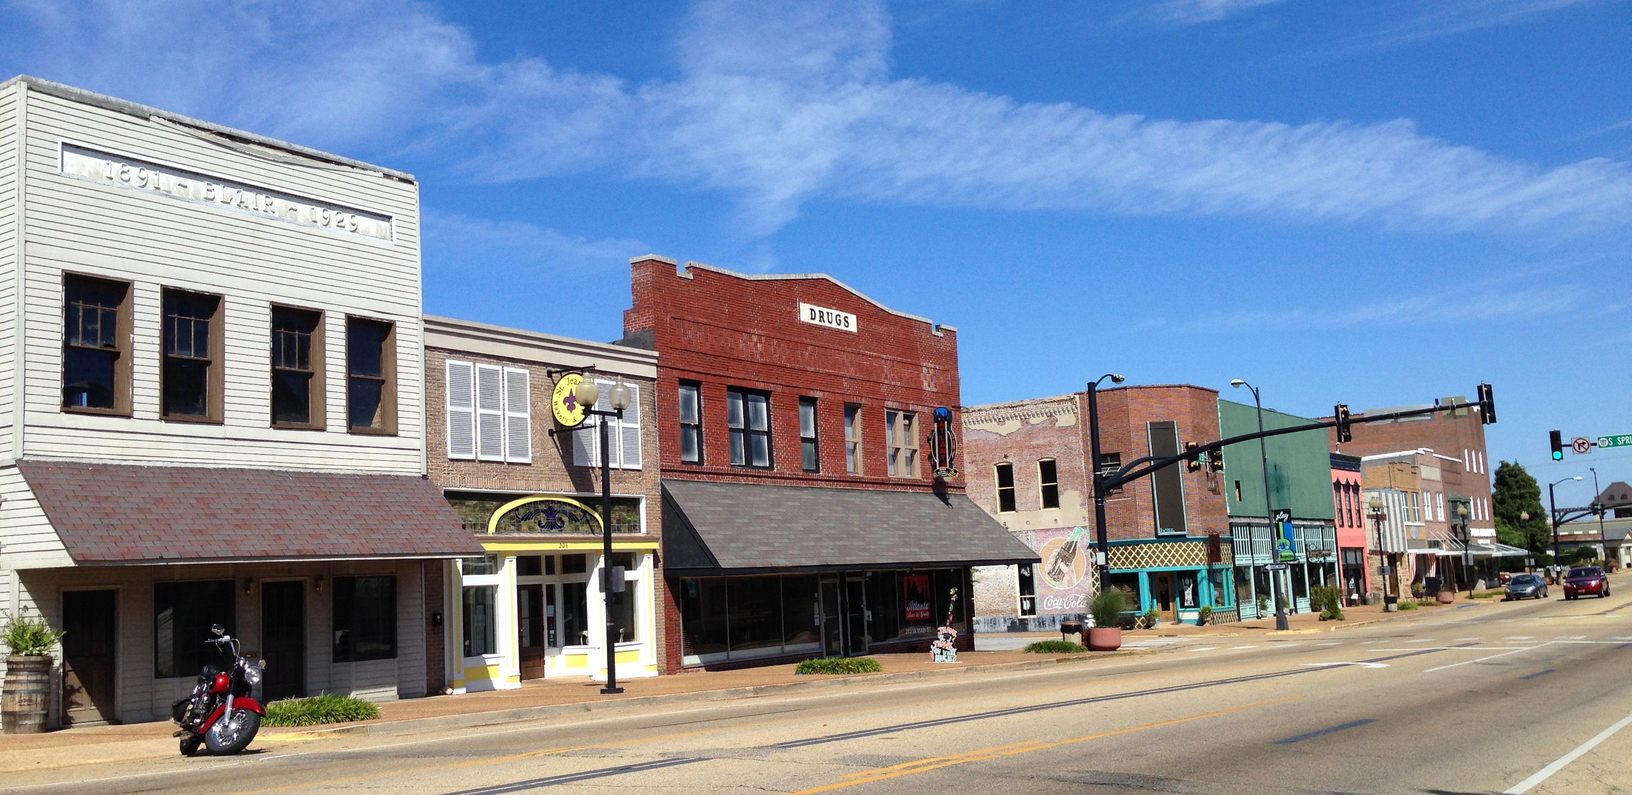

Distressed Cities and Persistent Poverty Technical Assistance(DCTA) Program

Slide 70
DCTA Program Overview
Established in 2018 to build capacity of relatively small local governments that may not otherwise have direct access to HUD programs and TA resources
Primary goal to help local governments improve their fiscal health so they may be more successful in securing additional resources, completing projects, and meeting goals
TA may be available for a range of topics – including governance, management and administration; community engagement; grant administration and compliance; plan implementation, and partnership building
Focus on building capacity in ways that are sustainable (long-lasting) for the local government

Slide 71
What is technical assistance?
HUD Definition: Guidance which enables recipients to overcome a lack of specific skills or knowledge and, by doing so, become more successful in meeting the needs of their communities. TA is the transfer of skills and knowledge to entities that may need, but do not possess, such skills and knowledge.
What does this mean in terms of DCTA?
The TA provider works directly with program recipients (local governments and sometimes their partners) to make progress in identified focus areas.
The recipient must be actively involved throughout the process. If the recipient is unresponsive, the TA must pause or terminate.
Typical recipients are very low capacity and successful recipients decide to make DCTA a priority.
The DCTA program cannot help a recipient if the recipient does not have capacity to engage and work with the TA provider.

Slide 72




DCTA Team
TA Providers Bring Expertise and Resources* to Local Governments
  Local Initiatives Support Corporation https://www.lisc.org/
  Enterprise Community Partners https://www.enterprisecommunity.org/
  BCT Partners https://www.bctpartners.com/
  PFM https://www.pfm.com/
HUD Funds, Directs, and Oversees TA Providers
*A recipient typically receives TA from one primary provider. HUD determines the most appropriate provider based on local government needs and program resources.

Slide 73

DCTA Process
Local government requests assistance
HUD reviews request and meets with local government
Approved requests start with a capacity needs assessment (CNA)
CNA determines focus and scope of future direct TA
Local government and TA provider engage in capacity building TA
HUD and TA provider conduct follow-up

Slide 74
Example Table
Challenge or Opportunity Identified by recipient (local government) | Assessment TA Provider assesses capacity in specific areas based on the identified challenge or opportunity | TA Activities Tailored capacity building support is provided to pursue the opportunity or address the challenge | Desired Outcome A goal the recipient is working towards with the TA
Opportunity: state CDBG-DR funds will be made available through a competitive process | Fiscal health Financial management practices Community background | Support in remedying recent adverse financial audit findings. Training in grant management. Support in reviewing funding opportunities and drafting a competitive application. | Local government receives CDBG-DR funds for identified project.
Challenge: chronic disinvestment in downtown | Existing partnerships Community assets Demographics Planning documents Economic development history | Assist in development of local program to support small business owners. Provide guidance on strategy for attracting larger employers. | Establish a coalition of local businesses and organizations invested in improving downtown. Secure funding for main street store façade restoration.

Slide 75
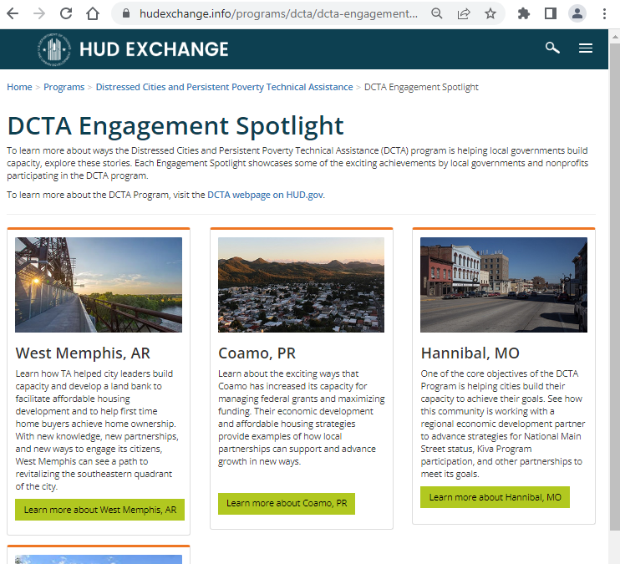
Engagement Spotlights
States and Territories with DCTA Recipients
Alabama
Arizona
Arkansas
California
Louisiana
Minnesota
Mississippi
Missouri
New Jersey
Oklahoma
Oregon
Pennsylvania
Puerto Rico
https://www.hudexchange.info/programs/dcta/dcta-engagement-spotlight/

Slide 76
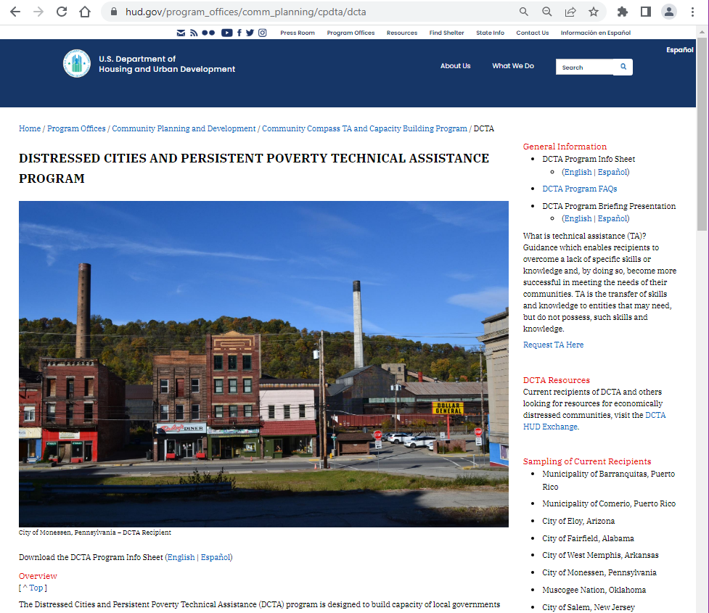
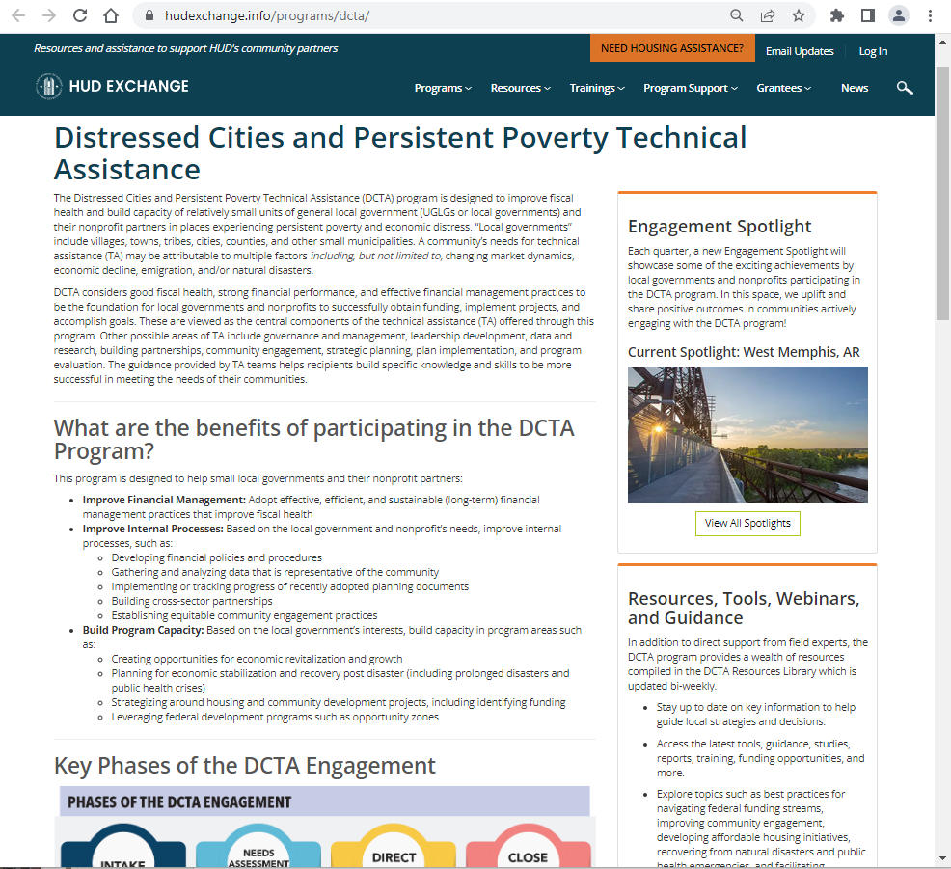

Web Resources
Local governments may learn more and request TA via the DCTA webpage on HUD.gov and the HUD Exchange
Request
TA Here
https://www.hud.gov/program_offices/comm_planning/cpdta/dcta
https://www.hudexchange.info/programs/dcta

Slide 77
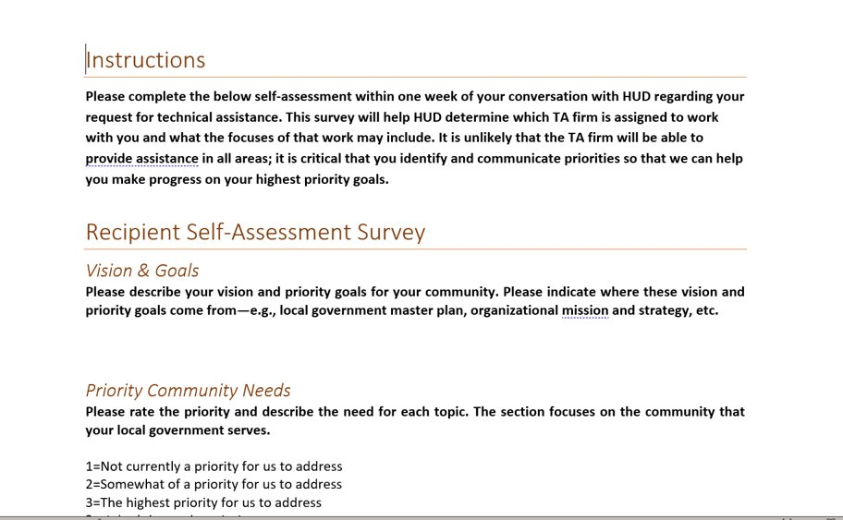
Complete Self-Assessment
Email completed self-assessment to distressedcities@hud.gov

Slide 78
Other HUD TA Resources
Do you receive and manage HUD funds? If yes, HUD’s Community Compass program may be a good fit for you.
  https://www.hudexchange.info/program-support/technical-assistance/
Do you currently have federal or state transportation funding slated for a project that will have housing impacts? If yes, HUD’s Thriving Communities program may be a good fit for you.
  https://www.hud.gov/program_offices/comm_planning/cpdta/tcta
Are you looking for high quality resources related to HUD’s programs, or community development in general? Check out the HUD Exchange, a treasure trove of resources.
  https://www.hudexchange.info/

Slide 79

QUESTIONS????

Slide 80
Contact Information
Lori Serino
202-304-5765
Lori.A.Serino@hud.gov
CPD Director

Slide 81
Contact Information
Jeremy Locklear
678-732-2104
Jeremy.S.Locklear@hud.gov
MFH Branch Chief

Slide 82
Contact Information
Courtney Kyles
601-608-1729
Courtney.N.Kyles@hud.gov
Acting PIH Director

Slide 83
Contact Information
Stan Marion
678-732-2639
Stanley.K.Marion@hud.gov
OHC Management Analyst

Slide 84
Contact Information
Morgan Clark
601-608-1748
Morgan.C.Clark@hud.gov
OHC
Housing Program Specialist

Slide 85
Contact Information
Adrenace “Shae” Williams
202-856-6153
Adrenace.V.Williams@hud.gov
Field Office Director

Slide 86

Follow us at:
@HUDSoutheast
@HUDgov

Slide 87
Thank You!!

